Slide 1

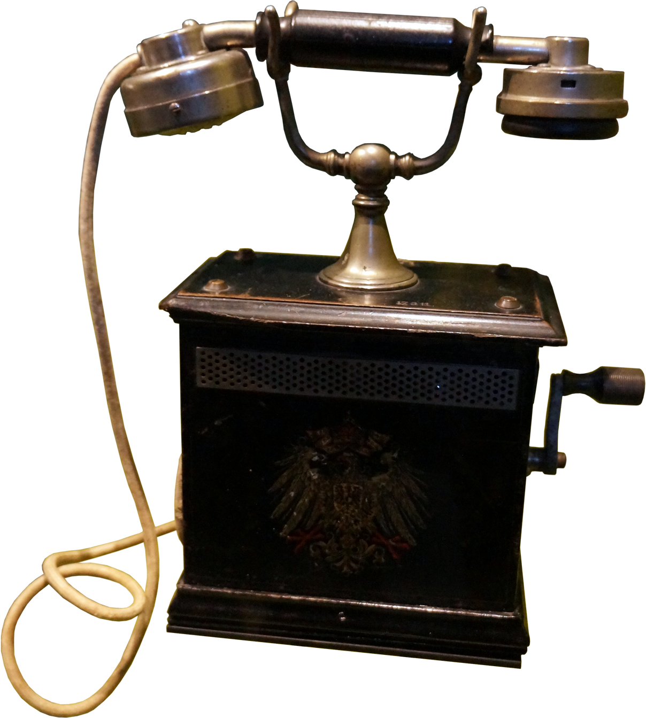

SyriaTel Company
CUSTOMER
CHURN
Presented by Tabby, Mark, Chris, Jacky & Wilkins

Slide 2


TABLE OF CONTENTS
The areas that will be tackled in this presentation:-
Problem Statement
Data & Stakeholders
The process
Data Understanding
Evaluation

Slide 3




PROBLEM STATEMENT
Predictors
State
The area of focus is customer churn in Syria Tel company.
The aim is to reduce financial impact of customer churn by implementing proactive retention strategies.
The research questions are;
What are the indicators of customer churn?
Which state has the highest churn rate?
Duration
Calls Charge
How does the calls duration affect Churn?
Does the calls charge affect Churn?
Customer service
International calls.
Is there need to review SyriaTel’s customer service?
Do we need a review of the International calls service?

Slide 4


DATA & STAKEHOLDERS
SyriaTel serves customers spread across 51 states.
States
The individuals for whom the research was carried out is the telecom business.
The data presented to us for analysis had the following characteristics:-
The data provided contains calls duration and charge for day, evening and night.
Calls data
The state of the customer churn is also provided. Therefore of all calls we are told whether the customer is active or not.
Churn

Slide 5



Data Exploration
THE PROCESS
This involves taking time to understand the business , understand the data and finally prepare the data for analysis.
The researcher employed various techniques to analyse the data.
The process has been outlined as follows:-
Data modelling
This involves carrying out various analytical procedures to gain insights from the data.
Results Evaluation
This involves outlining the insights analytics gained from the data.

Slide 6
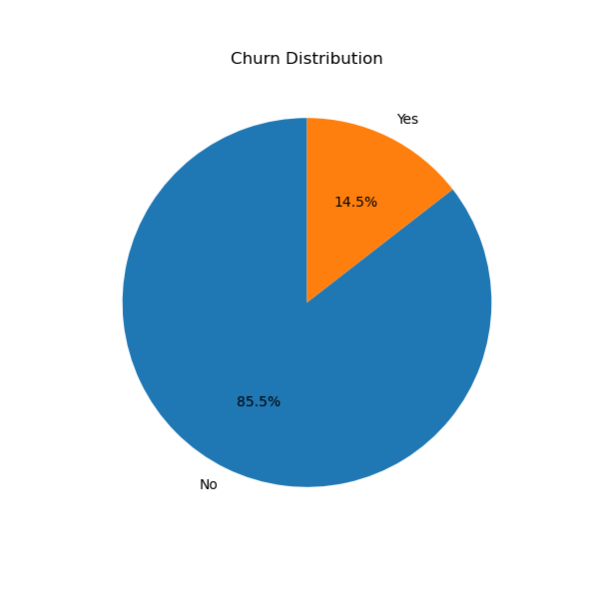
CURRENT CHURN RATE
3,333
Total client sample used to carry out the analysis
14.5%
Churn rate percentage from the client sample.

Slide 7
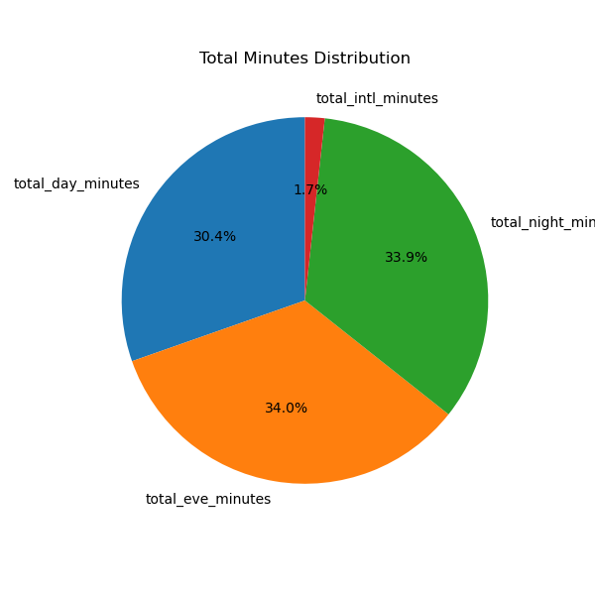
CALLS DISTRIBUTION
The pie chart shows no significant difference between average call minutes during the day, night, and evening.
The chart shows the potential for growth of the international business.

Slide 8
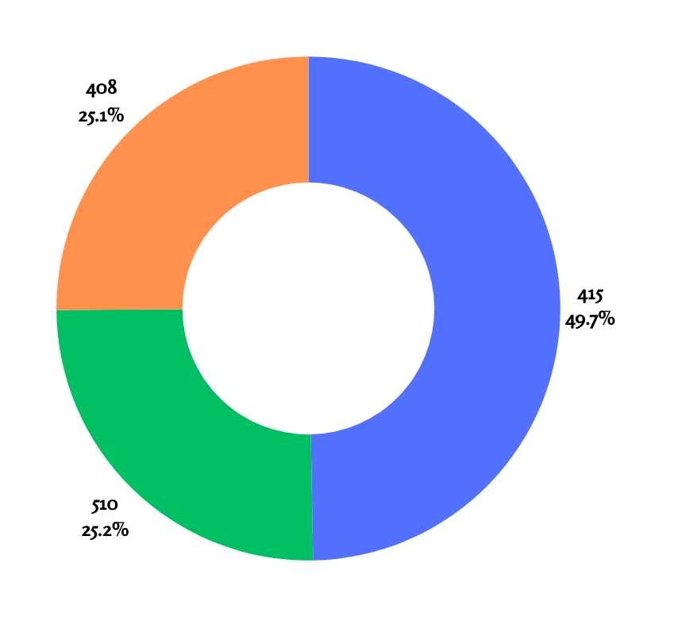
AREA CODE DISTRIBUTION
The majority of the customers are from the 415 area code with 49.7% originating from there.
The remaining two area codes, 408 and 510 have almost similar distribution of 25.1% and 25.2% respectiviely.

Slide 9
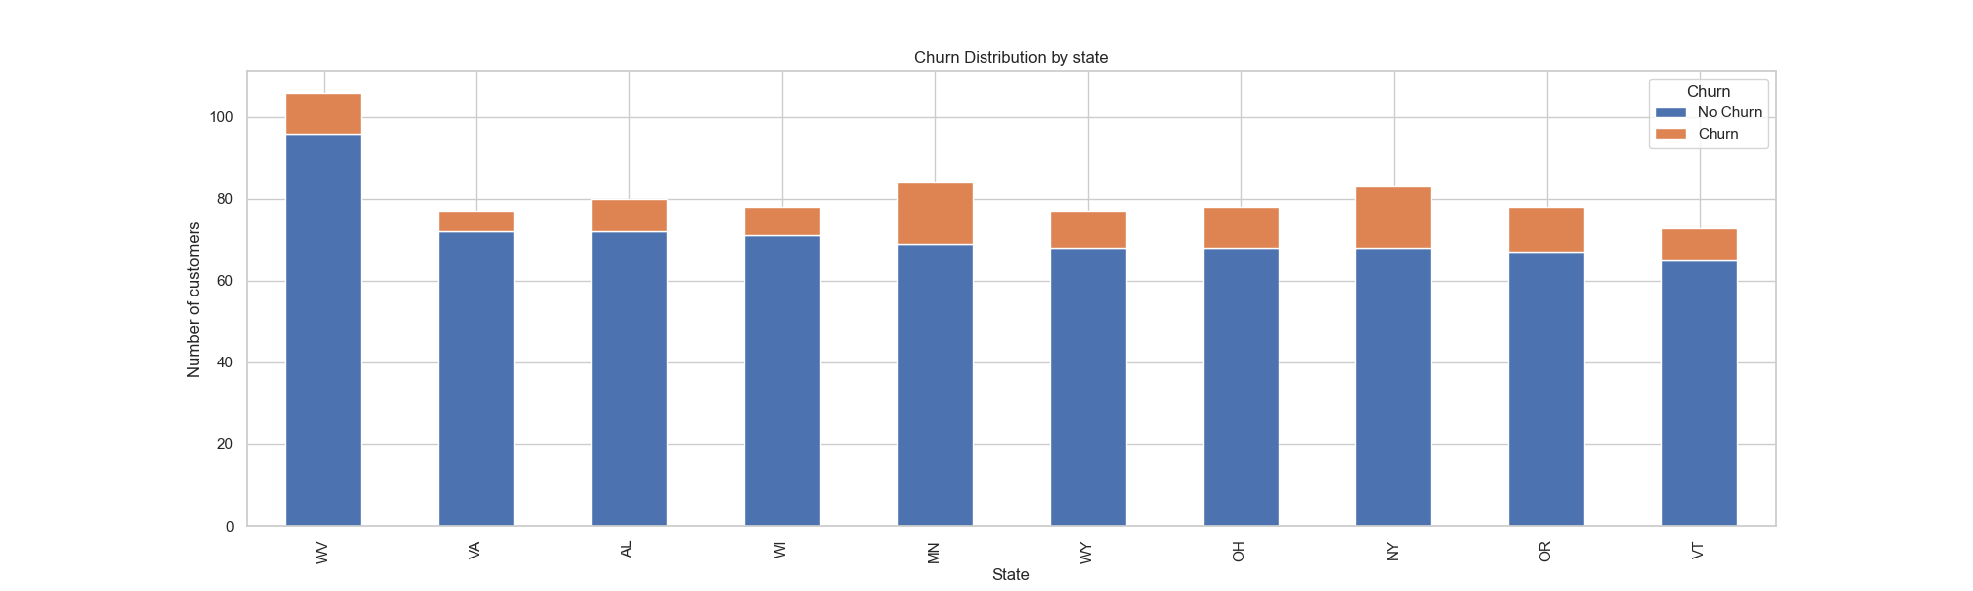
CHURN DISTRIBUTION BY STATE
The graph below shows that we have the highest retention in West Virginia (WV) followed by Virginia (VA) then Alabama (AL).

Slide 10
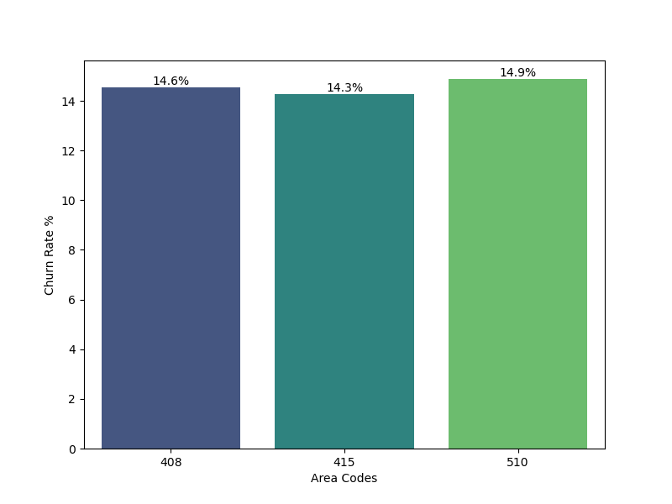
CHURN DISTRIBUTION BY AREA CODES
Area code 510 had the highest churn rate (14.9%).

Slide 11
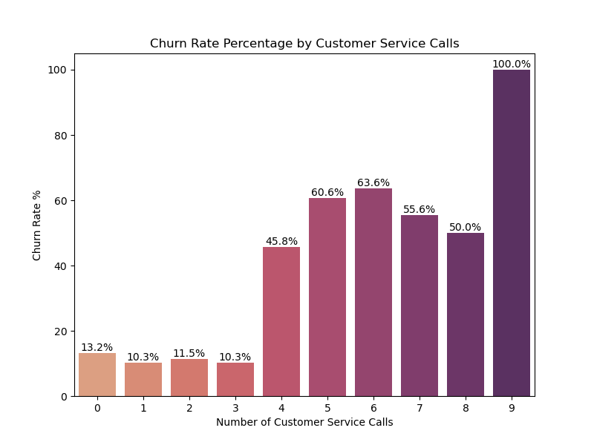
CUSTOMER SERVICE AGAINST CHURN
The bar graph shows an increase in churn rate versus the number of customer service calls.
An increase in customer service calls is an opportunity for the business to retain the client before they exit.

Slide 12
EVALUATION
The top predictors of customer churn are;
Calls duration
International plan subscriptions.
Customer service calls
Predictors
The analytics carried out revealed the following:-
The model built is able to predict instances of churn or no churn by customers to an accuracy of 92%.
Model
The state of the customer churn is also provided. Therefore of all calls we are told whether the customer is active or not.
Churn

Slide 13
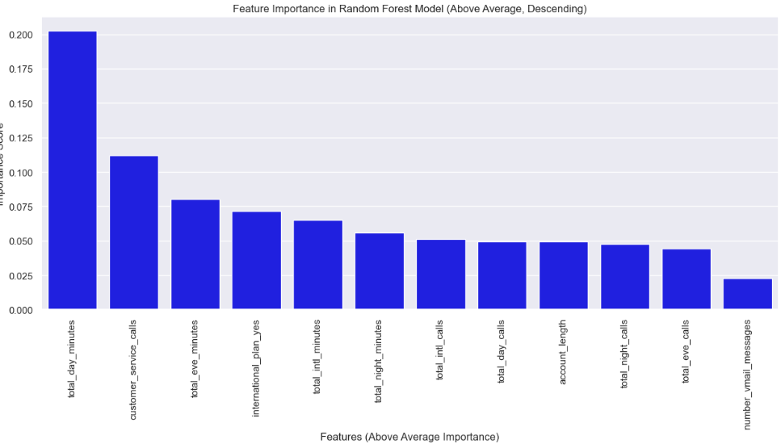
PREDICTORS OF CUSTOMER CHURN
What Order of feature importances.
What are the areas of key focus.

Slide 14
RECOMMENDATIONS
Improve call quality during the day as this has proved to be the most important indicator of churn.
Improve customer care services for better customer experience.
Offer better rates or packages for customers with international plan.
For the data we recommend inclusion of date for better analytics on trends.

